Slide 1
Descriptive & Inferential Graphs for Inc5000-2014 Mehmet Tiras-May/2020

Slide 2
Regression Equation proves that larger employees do not mean more revenue.

Slide 3
Companies clustered between $2 Billion by Revenue and %20000 by Growth in 2014

Slide 4
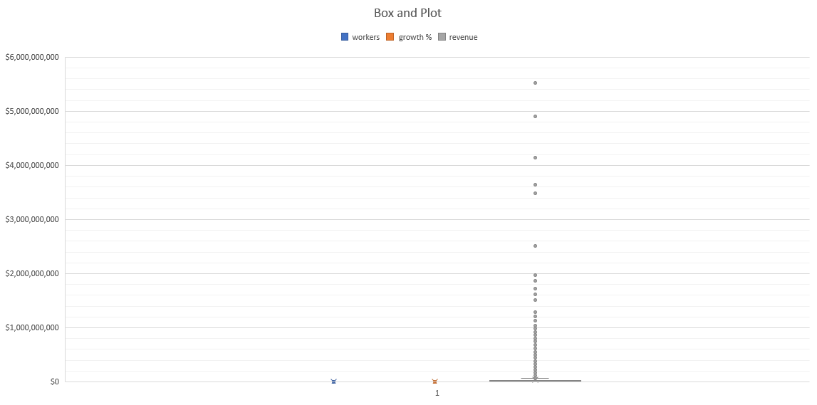

Slide 5
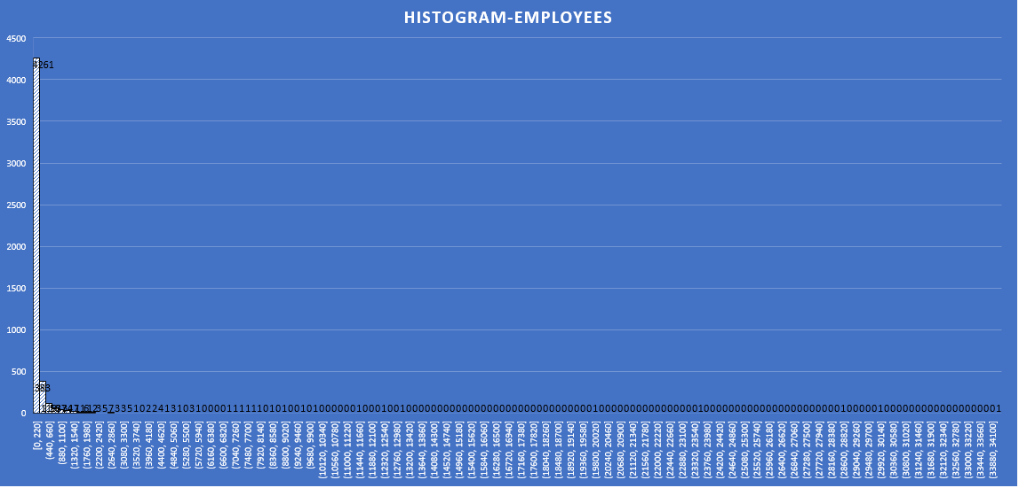
The number of employees clusters in between 0-220 mostly.

